Slide 1
C# Syntax & Vocabulary Intro

Slide 2
Disclaimer
Some of this presentations syntax & vocab is based on topics that you can’t just study and understand; rather you need an actual situation or problem to solve that requires these strategies to practice.
For these difficult to represent topics, I am sharing them with you to allow you to “get your feet wet” so that when the time comes to use them, you will be able to figure it out from there.
I’ve written hundreds of thousands (maybe millions?) of lines of code and I’ve never had to use some of these topics; partially because they are often times optional.

Slide 3

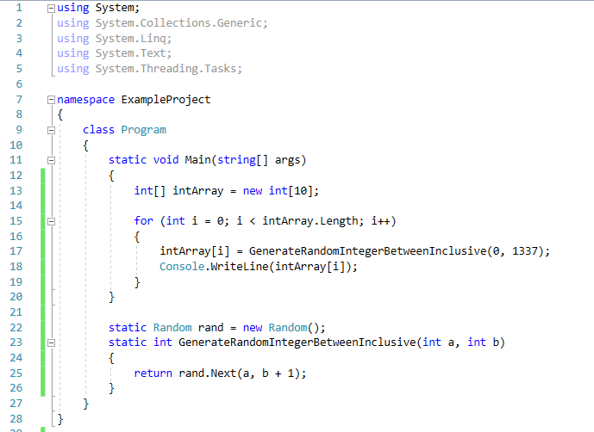

Slide 4
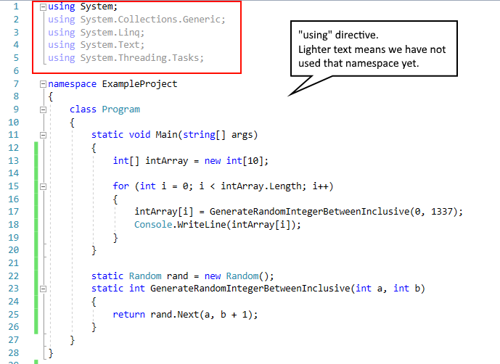
https://docs.microsoft.com/en-us/dotnet/csharp/language-reference/keywords/using-directive

Slide 5
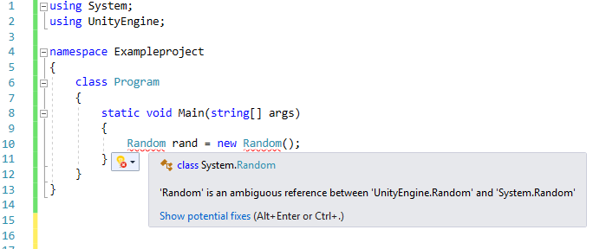
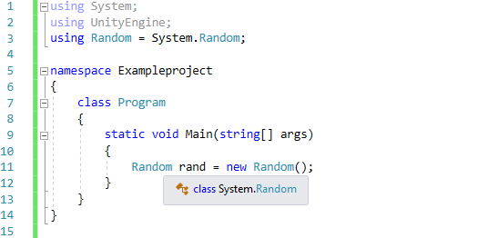
https://docs.microsoft.com/en-us/dotnet/csharp/language-reference/keywords/using-directive

Slide 6
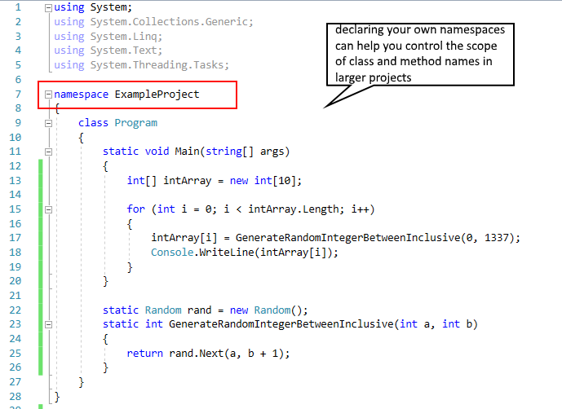
https://docs.microsoft.com/en-us/dotnet/csharp/programming-guide/namespaces/

Slide 7
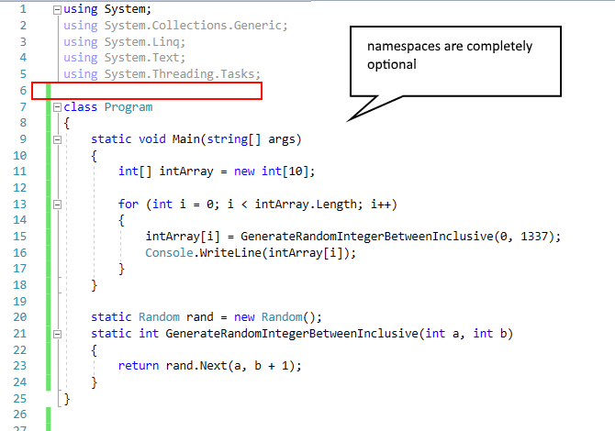
https://docs.microsoft.com/en-us/dotnet/csharp/programming-guide/namespaces/

Slide 8
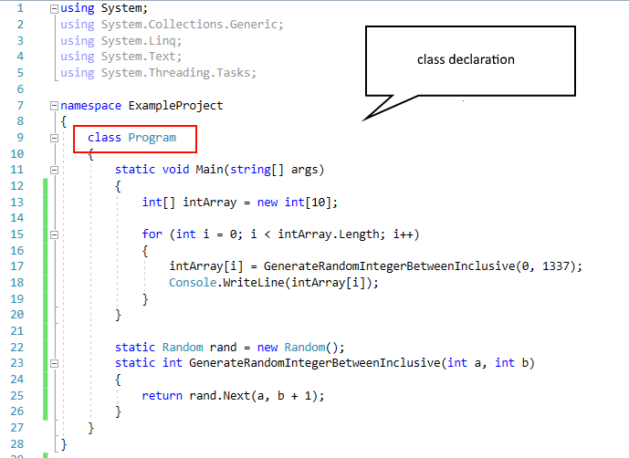
https://docs.microsoft.com/en-us/dotnet/csharp/programming-guide/classes-and-structs/classes

Slide 9
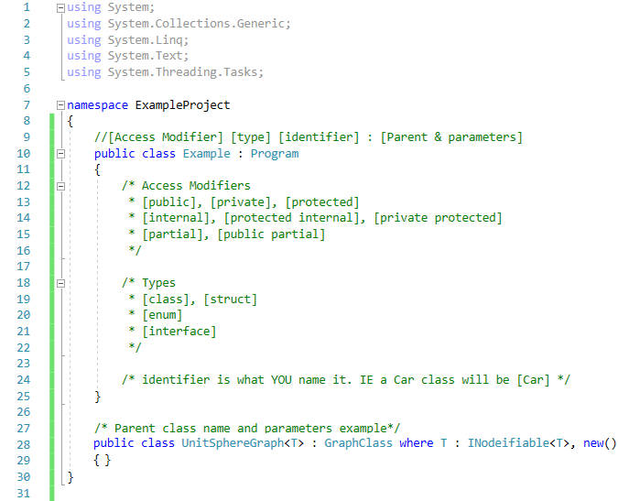
Many of these options are optional
You only NEED a type and identifier
The rest is useful in advanced development
https://docs.microsoft.com/en-us/dotnet/csharp/language-reference/keywords/accessibility-levels
https://docs.microsoft.com/en-us/dotnet/csharp/programming-guide/classes-and-structs/access-modifiers
https://docs.microsoft.com/en-us/dotnet/csharp/programming-guide/classes-and-structs/classes
http://www.tutorialsteacher.com/csharp/csharp-partial-class

Slide 10
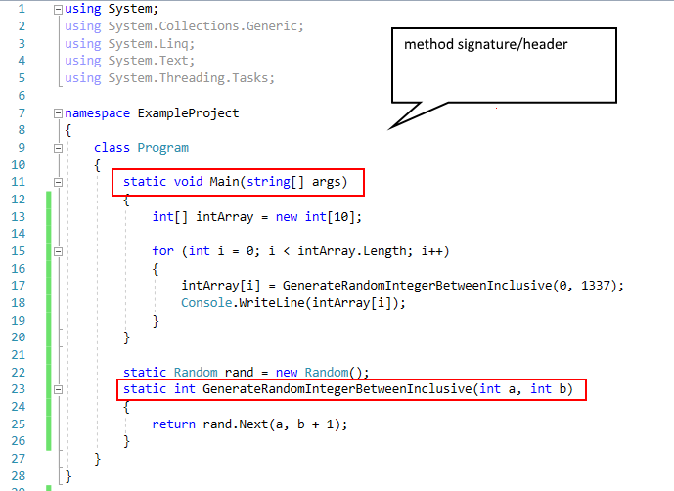
https://docs.microsoft.com/en-us/dotnet/csharp/programming-guide/classes-and-structs/methods

Slide 11
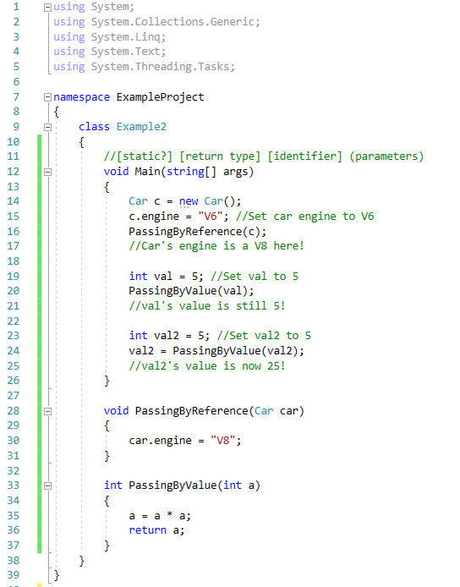
Parameter vs Argument
Parameter = The layout, or possible types to request as arguments.
Arguments = The actual values you send into the method.
Static vs not static
A static member simply means that the method, property, field, etc is a member of the entire class…
A non-static member means that it belongs to the individual object itself.
Passing by reference
Even though we don’t necessarily return any value we are still directly modifying the object.
Passing by value
The object sent as an argument does not get modified.
Its value is used and can be changed directly in the method, but it won’t reflect outside.
Parameters vs arguments Static classes & static members By Value By Reference

Slide 12
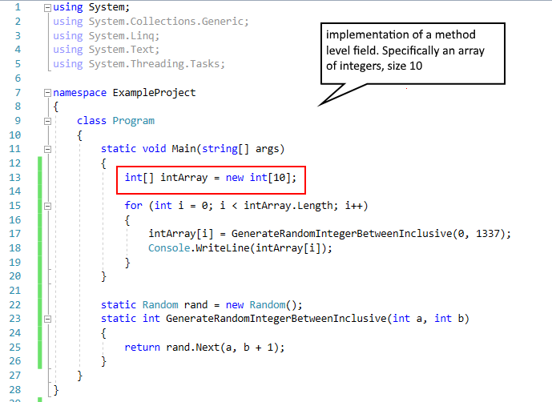
https://docs.microsoft.com/en-us/dotnet/csharp/programming-guide/classes-and-structs/fields

Slide 13
Array specific syntax
int array[5], int array[] = {0,1,2,3,4}, the “C/C++” way of doing it
int array[], int[] array = new int[5] {0,1,2,3,4}, the “Java” way of doing it
int[] array, int[] array = new int[5] {0,1,2,3,4}, the “C#” way of doing it

Slide 14
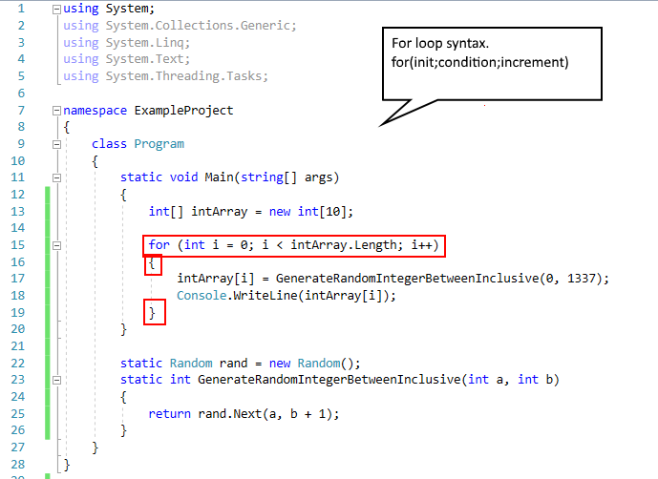
https://docs.microsoft.com/en-us/dotnet/csharp/language-reference/keywords/for

Slide 15
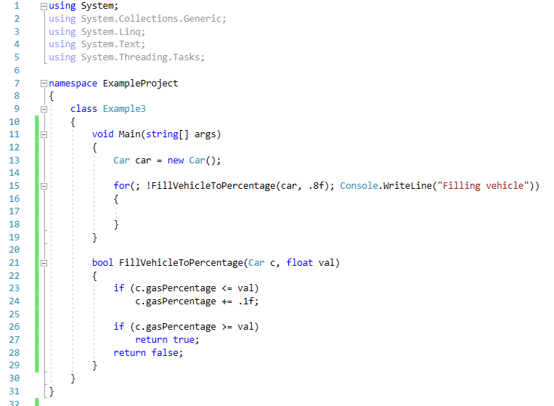
For loops can be stupid… Only you can prevent stupid for loops.
Just know that developers exist that do stuff like this. So when you see it, find out who did it and scold them.
Assuming the car starts empty, what does this program do?
https://docs.microsoft.com/en-us/dotnet/csharp/language-reference/keywords/for

Slide 16
Vocabulary
abstract | as | base | bool | break | byte
case | catch | char | class | const | continue
decimal | default | delegate | do | double | else
enum | event | false | finally | float | for
foreach | goto | if | in | int | interface
is | lock | long | namespace | new | null
object | operator | out | override | params | private
protected | public | readonly | ref | return | sbyte
short | static | string | struct | switch | this
throw | true | try | typeof | uint | ulong
ushort | using | value | virtual | void | while
Note: This is not a complete list.
Also Note: This table may not appear on Canvas’s previewer. Download file to view.
By the end of the semester, you should be able to explain what each of these keywords are and what they are used for.
https://docs.microsoft.com/en-us/dotnet/csharp/language-reference/keywords/

